Slide 1

Connected Campus
Mark Girguis, Kishan Patel, Ankit Monga,
Eric Gonzalez, Jason Chung, Hector Khuon

Slide 2
The Team | Roles
Mark Girguis - Project Manager
Kishan Patel - Programmer
Ankit Monga - Data Analyst
Eric Gonzales - Business Analyst
Jason Chung - Systems Designer
Hector Khuon - Quality Assurance

Slide 3
Process Models

Slide 4
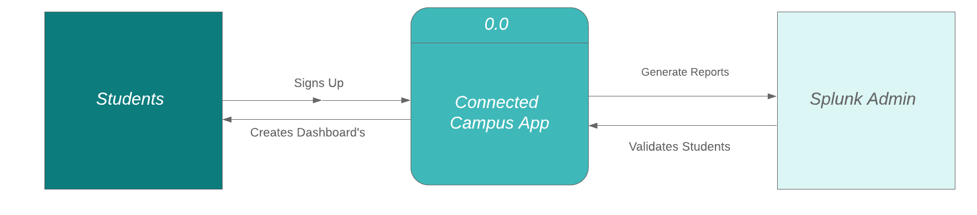
Context Diagram

Slide 5
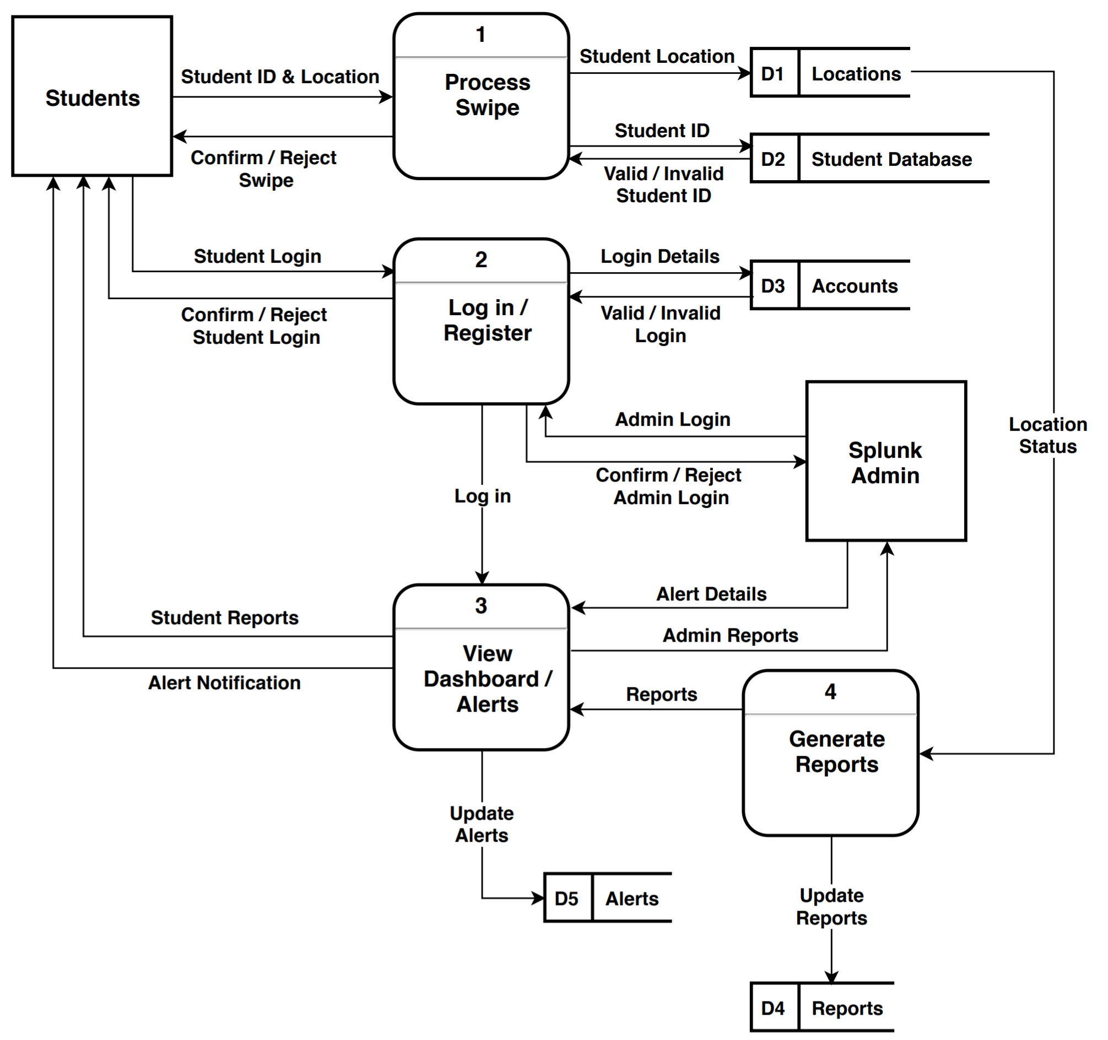
Diagram 0

Slide 6
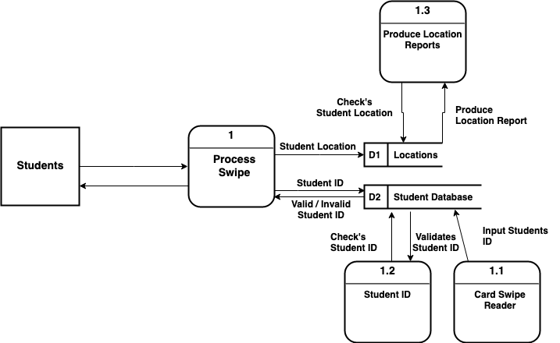
Level 1 Diagram, Process 1:

Slide 7
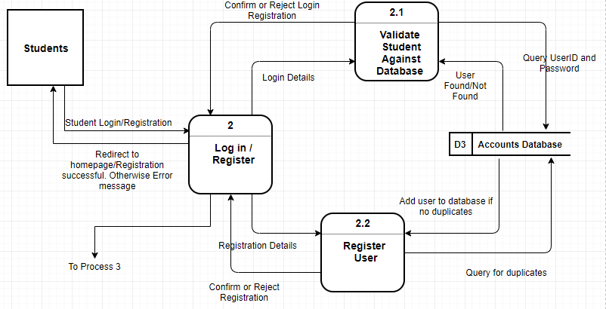
Level 1 Diagram, Process 2:

Slide 8
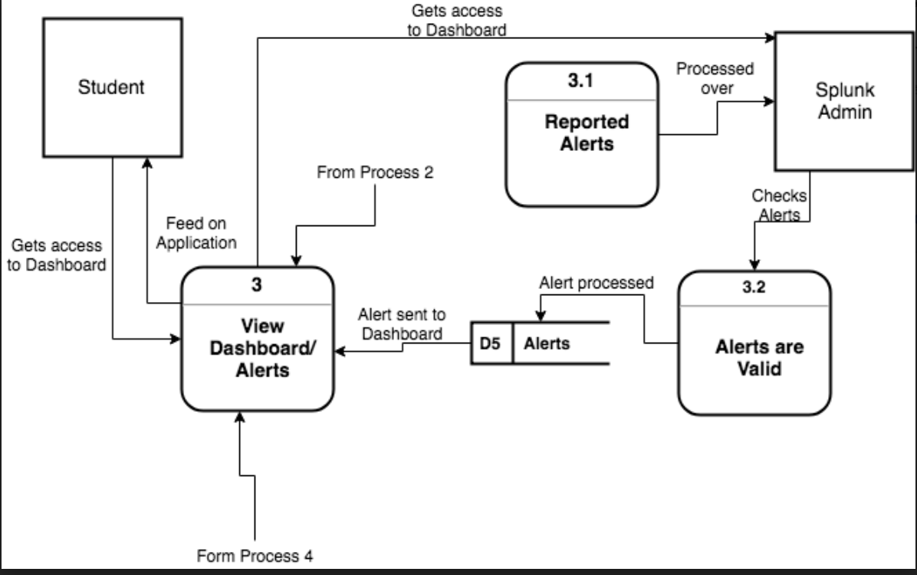
Level 1 Diagram, Process 3:

Slide 9
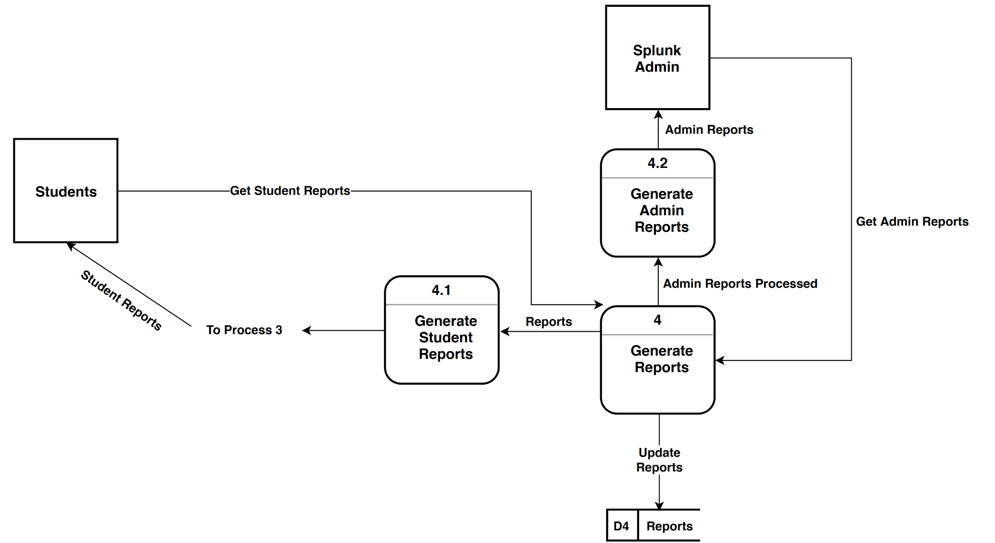
Level 1 Diagram, Process 4:

Slide 10
Use Cases

Slide 11
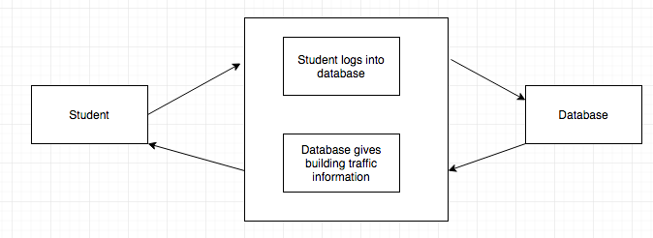
Use Case 1
Use Case 1: Student Logs into database to see if the building they are visiting has high traffic at given time
Actors:
Student
Database
Flow of Events:
Use case starts when Student logs in
The system searches traffic information from swipe data
Student checks traffic information
The Database gives traffic info
Use Case ends.

Slide 12
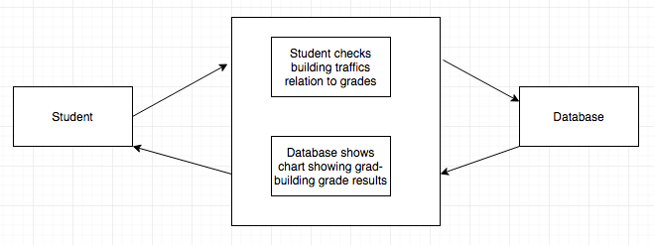
Use Case 2
Use Case 2: Student checks what time visiting a building is resulting in higher grades
Actors:
Student
Database
Flow of Events:
Use case starts when Student searches correlation between building traffic and grades
The system searches data for traffic and grades of students and finds which building is resulting in higher grades
Student checks report
Use Case ends.

Slide 13
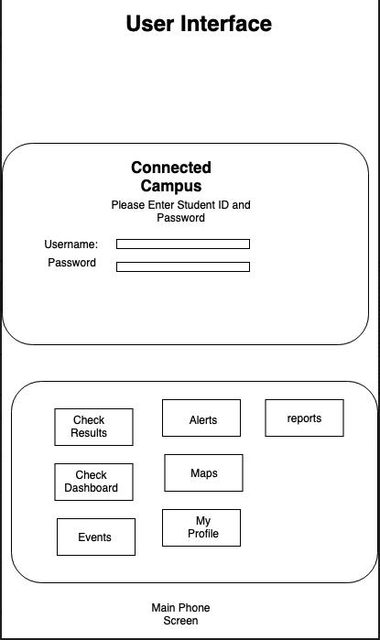
Use Case 4
Use Case 4: (Log in)Proposed User Interface for mobile application version of Connected campus
Actors:
Students
Admin
Flow of events:
Use Case Starts when Student Opens the Mobile Application
Student then log in with ID and password
Student then selects the different application options.
Case use end.
Scenarios
· Bad User Name
· Bad password
· Too many attempts to log in, account on hold
· Admin has the control for students logins.

Slide 14
Functional & Non-Functional Requirements

Slide 15
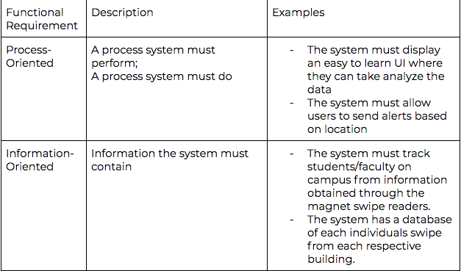
Functional Requirements

Slide 16
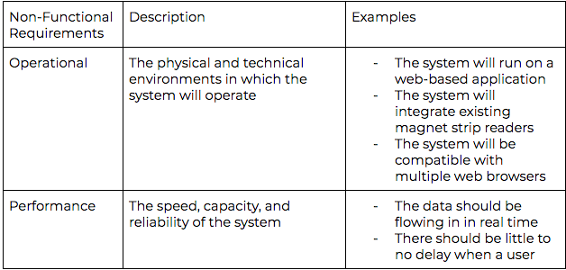
Non-Functional Requirements

Slide 17
Definitions

Slide 19
Project Plan

Slide 20
